Slide 1
What we know about Guided Pathways
Modesto Junior College
Spring 2018

Slide 2
Understanding the Need
MJC’s mission is to “. . . Transform lives through programs and services informed by the latest scholarship of teaching and learning. […]”

Slide 3
Why Guided Pathways?
Examining institutional data helped us see the need to improve the student experience in:
Academics
Support Services
Pathways to long-term goals

Slide 4
Program Completion
MJC currently offers 229 degree or certificate programs
In 2016-17, MJC granted 2,084 awards
(24, 428 students enrolled)
There were no student completions in 87 programs (38%)
MJC Office of Research, 2017
Datamart, 2016-17 Annual Student Count

Slide 5
Completion (degree, certificate, transfer)
Measure: First time students with 6 units and math or English who graduate or transfer within 6 years.
Many students are not counted at all.
MJC has a 43% completion rate
MJC Office of Research, 2017

Slide 6
1. What is Guided Pathways?
An institution-wide approach to student success:
Helps students choose and complete a program of study
Leads to a job or transfer in a timely manner
Driven by evidence

Slide 7
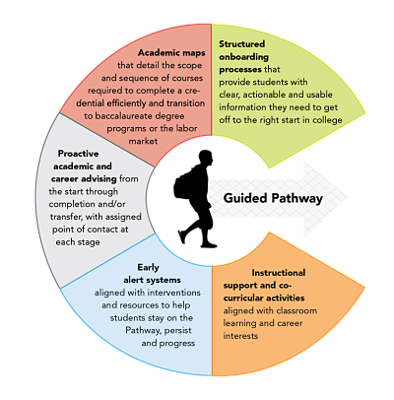
Elements of Guided Pathways
Structured onboarding processes
Academic maps
Proactive academic and career advising
Early alert systems
Instructional support and co-curricular activities

Slide 8
2. How is it different from other initiatives or fads?
Requires a holistic analysis of our college
Provides a framework to improve or redesign the student experience
Leads to more timely completions

Slide 9
3. How will pathways impact equity gaps?
Georgia State University graduation rates by ethnicity after implementing Guided Pathways
Rob Johnstone,
Guided Pathways Demystified

Slide 10
4. Shouldn’t the strong and smart succeed?
66% of students from the top income quartile graduate college by age 24
17% of students from the bottom income quartile graduate college by age 24
Guided Pathways Demystified

Slide 11
Impact of socio-economic differences

Slide 12
5. Isn’t choice the cornerstone of higher education?
Focus on choosing a program instead of a course or courses.

Slide 13
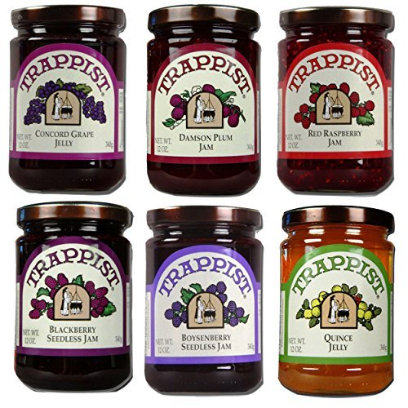
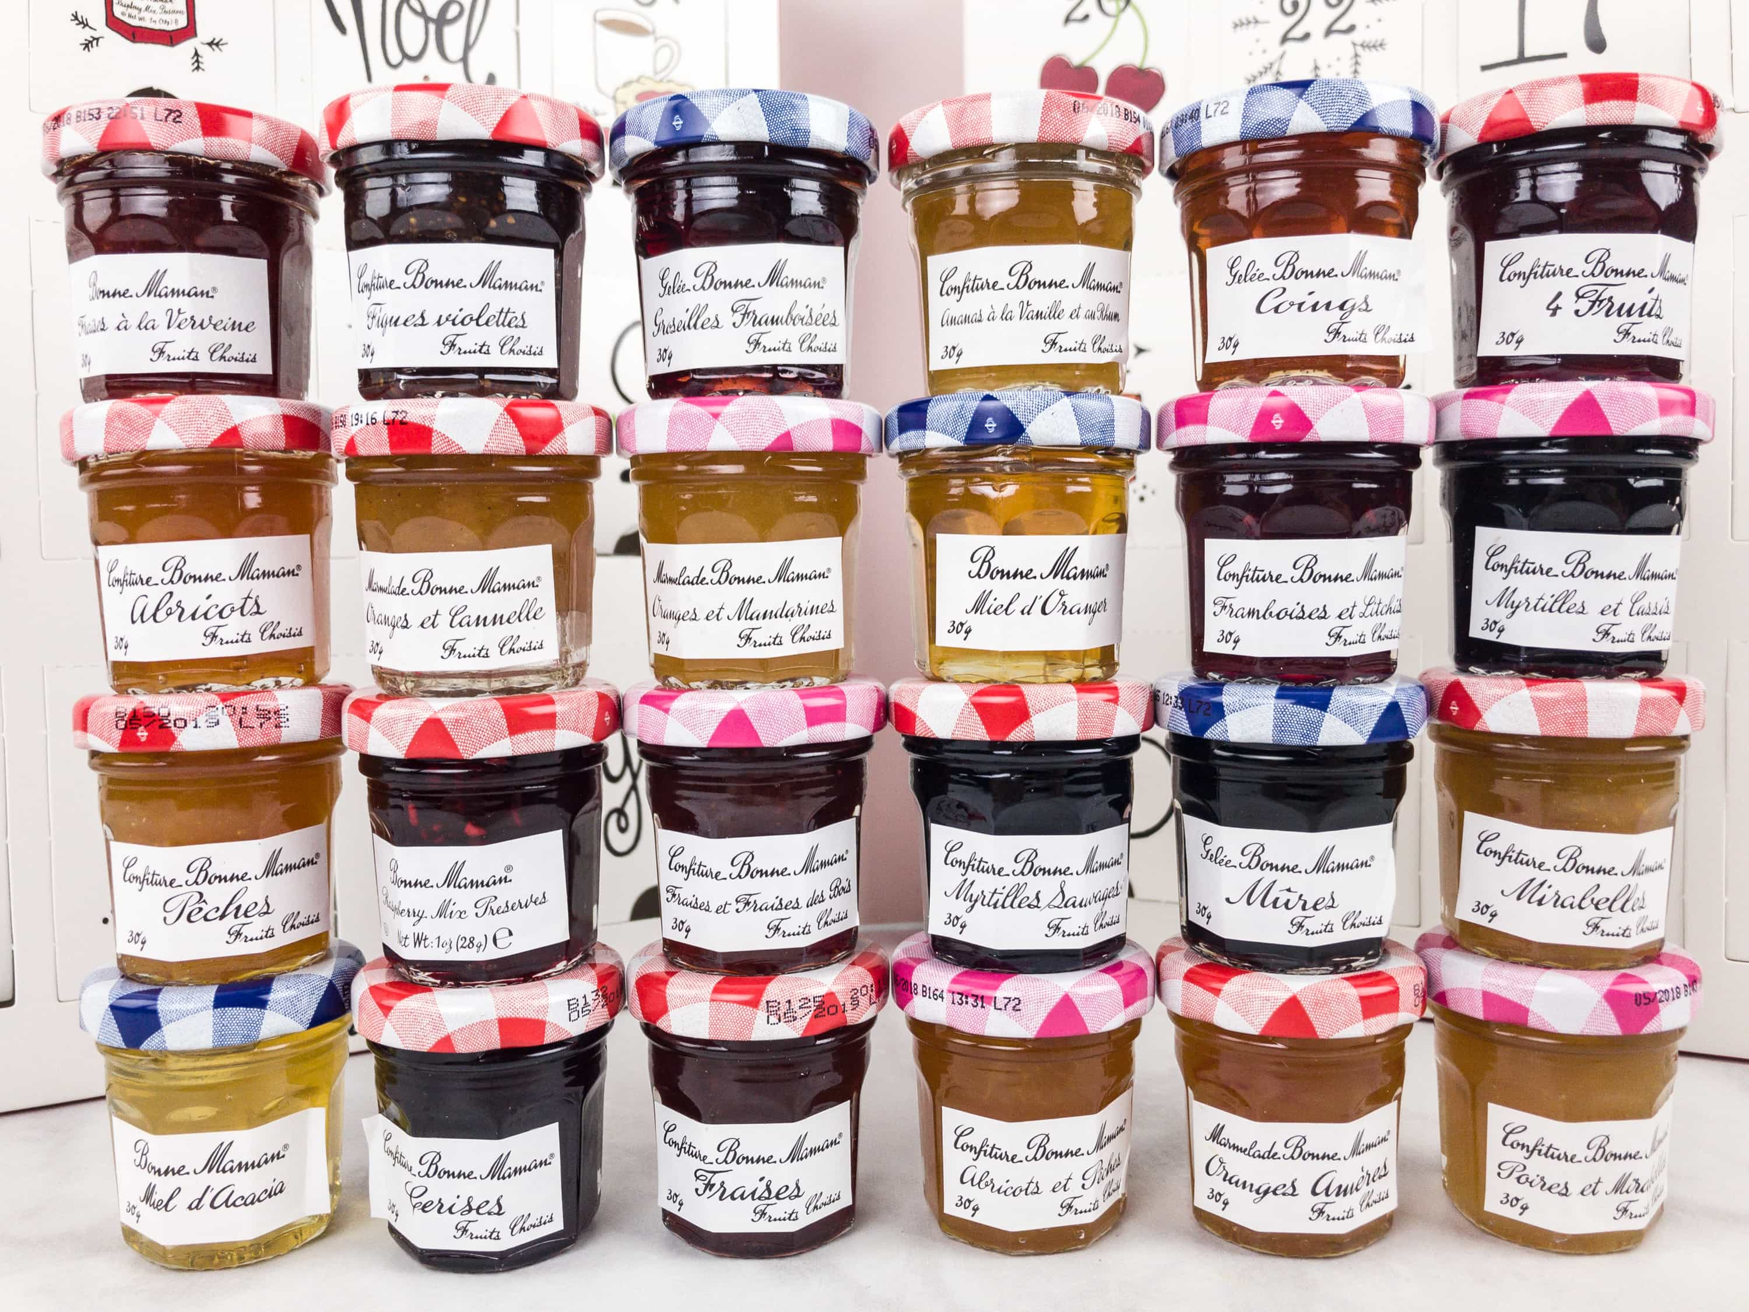
Research findings about choices
Display: 6 Types of Jam:
40% of shoppers tasted
30% purchased
Display: 24 Types of Jam
60% of shoppers tasted
3% purchased
Iyengar & Lepper, 2000

Slide 14
“Guided pathways encourages organizing a choice architecture that is planned rather than haphazard.”
Rob Johnstone,
National Center for Inquiry & Improvement

Slide 15
6. What happens if students change their mind?
Start with general areas of focus
Common courses in the first 15-30 units
Foundational work that fits multiple programs

Slide 16
7. Won’t we sacrifice quality and variety?
Identify GE courses that complement disciplinary requirements
Examine how PLOs are organized and how they lead to ILOs
Organize courses and sequences that build on prior learning and articulate to four-year universities

Slide 17
8. Don’t students benefit when they “find themselves” by wandering?
From the Six Success Factors:
Directed: students have a goal and know how to achieve it
Focused: students stay on track, keeping their eyes on the prize
Booth et al., 2012

Slide 18
Shift from “what courses should I take” to “what programs”?
General Interest Areas
Buckets
Career & Academic Pathways
Fields of Study
Programs
Sequenced courses that combine to meet ILOs
Support at key milestones
Jobs and/or Transfer
Internships
Courses articulate
Prepared for the next step

Slide 19
Pathways Implementation at MJC
FALL
2020
Spring 2018
Develop Metamajors
Fall 2018
Trainings on Program Mapping
Spring 2019
Continued Program Mapping and editing
Fall 2019
Complete and finalize the first draft of guided pathways materials
Spring 2020
Materials in place for early rollout in high schools, advising, and summer FTIC programs
Safe First Year
Programs complete maps
Develop Catalogue and Website Materials

Slide 20
Next Steps
Spring 2018 | Paving the Path
January 25 | Demystifying Guided Pathways II
February 8 | Aligning our Practice: From courses to programs…
February 22 | Sense-Making Session: Putting apples with apples or logical program groupings
March 8 | Creating that Safe First Year: Meta-majors and Common First-Semester Schedules
March 22 | Aligning Curriculum and Outcomes with Transfer Institutions
April 12 | Holistic Advising: Bringing Instruction and Student Services together…
We will hold a series of Thursday afternoon discussions (on weeks in which Senate does not meet) to explore the development steps and implications of guided pathways work.

