Slide 1
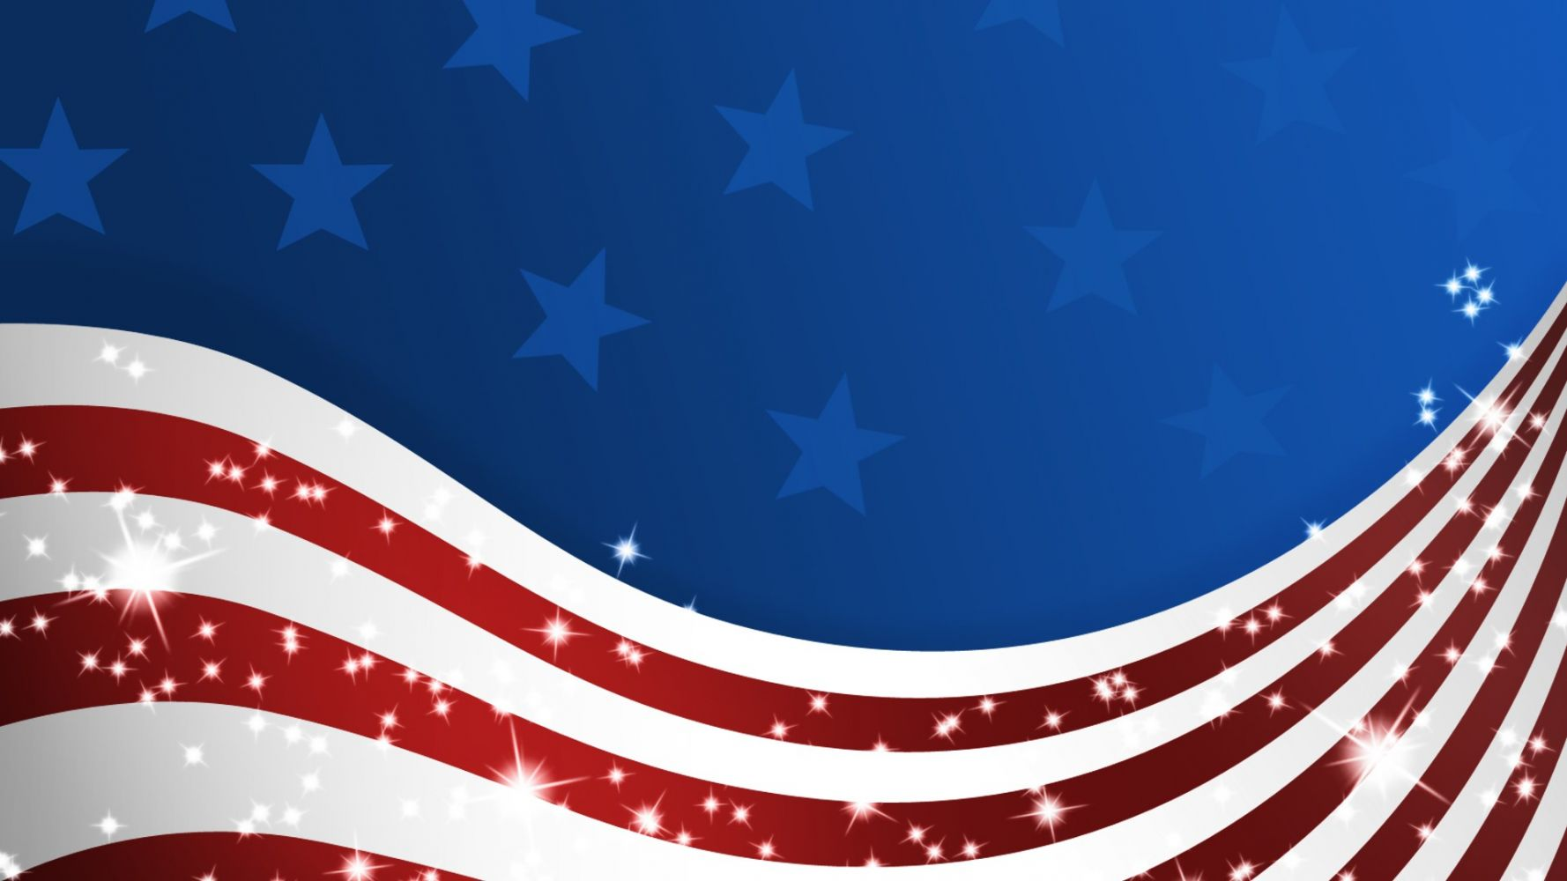
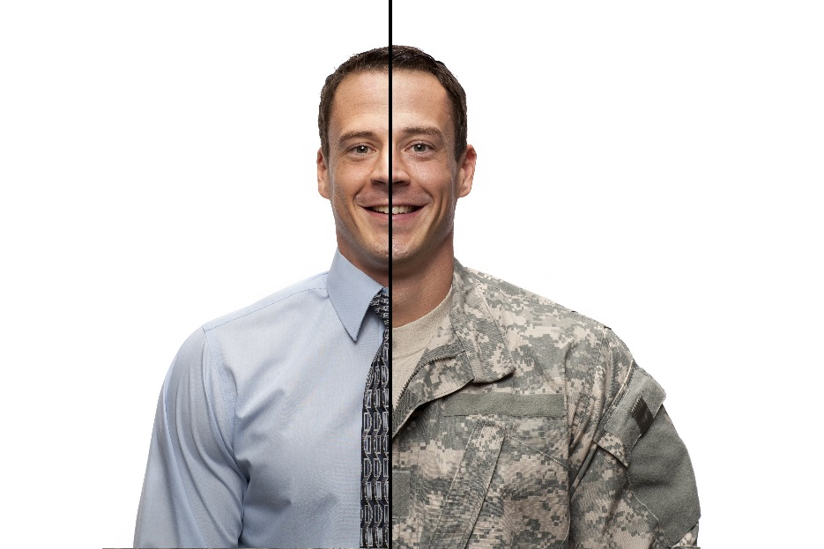
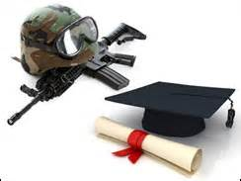

Slide 2
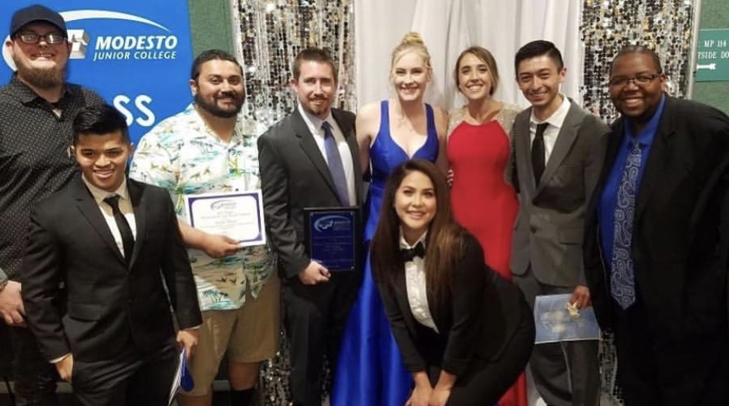
Veterans Services Mission
The mission of the Modesto Junior College Veteran Services department is to assist in the transition process and provide opportunities for success to our United States Military Veterans. MJC Veteran Services directly provides support services and acts as a bridge to external support services for student Veterans, active military personnel, and their loved ones.

Slide 3
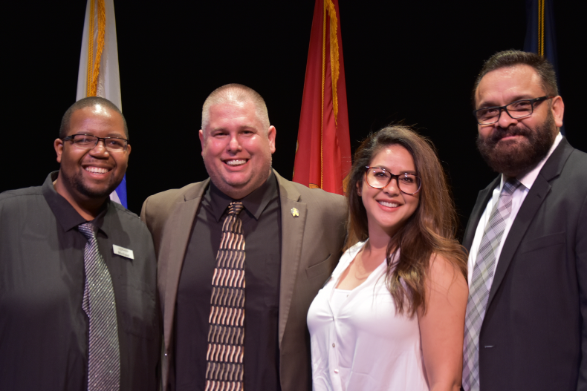
Veterans Services Staff
Fernando Velez (far right) oversees all things certification related.
Megan Lee (second from the right) serves as the program specialist and oversees veteran activities, outreach, marketing, and day to day program services.
Michael Jackson (far left) is the Veterans Services Counselor/Coordinator.
Bryan Justin Marks (second from the right) is the Associate Dean for Veterans Services.

Slide 4
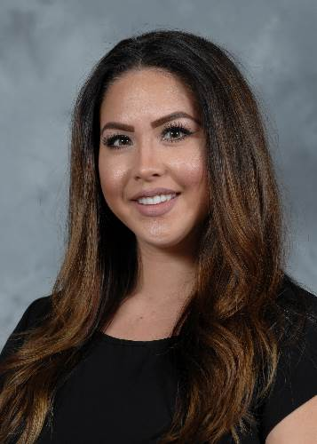
Veterans Services History
For its first 20+ years of existence, MJC Veterans Services operated out of a two-person cubicle in the Morris Building.
In 2012, MJC dedicated space to Veterans Services for the purpose of certification and to create a Veterans Resource Center.
In 2018, MJC dedicated a larger space to Veterans Services as they moved to the Student Center. Veterans services are administered through the Campus Life Office and the Veterans Resource Center (now double in size) sits across the hall.

Slide 5
Veterans Services Grants
In 2015, MJC applied for and was awarded the Center of Excellence grant from the Department of Education. The purpose of this grant was to provide an infrastructure to support veteran student success. The grant expires in September 2018.
In 2018, MJC was awarded a Veterans Resource Center grant by the state of California. This grant is specifically intended to enhance services for students using the Veterans Resource Center.

Slide 6
What is the Veterans Resource Center (VRC)?
Veterans Resource Centers are now a common facility on California Community College campuses.
The VRC provides students a place to congregate, study, socialize, participate in workshops, have use of computers and printers, and enjoy food items often donated by the community.
Most importantly, the VRC is a home to our Veteran students and their families when they are on campus.

Slide 7
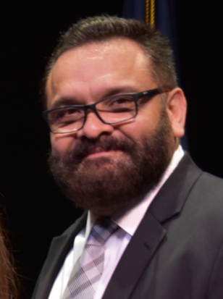
Veterans Services Certification
What Does Certification Mean?
Each school designates at least one VA Certifying Official to carry out reporting requirements. To say that a student has been certified is to say that they have been found eligible to use (and are using) their educational benefits for that particular semester’s classes.
MJC’s Certifying Structure:
Primary Certifier-Fernando Velez
Backup Certifiers-Megan Lee, Michael Jackson
Emergency Certifier-Bryan Justin Marks
The certifier is the official person responsible for working with a Veteran
or Veteran Dependent to ensure any and all eligible benefits are
awarded based on guidelines developed by the
United States Department of Veterans Affairs.

Slide 8
Veterans Services Certification
Responsibilities for Reporting: Checking enrollment status of Veterans and other eligible persons
and use of basic forms to keep VA informed, such as:
• Enrollment Certification (VA Form 22-1999) to report required enrollment information
• Notice of Change in Student Status (VA Form 22-1999b) to report changes to enrollment information
• Monitor the subjects pursued by a student to certify to VA only those subjects
that apply to the student’s program
• Monitor student’s grades to ensure satisfactory progress is being made.
• Monitor student’s conduct and report when student is suspended or
dismissed for unsatisfactory conduct

Slide 9
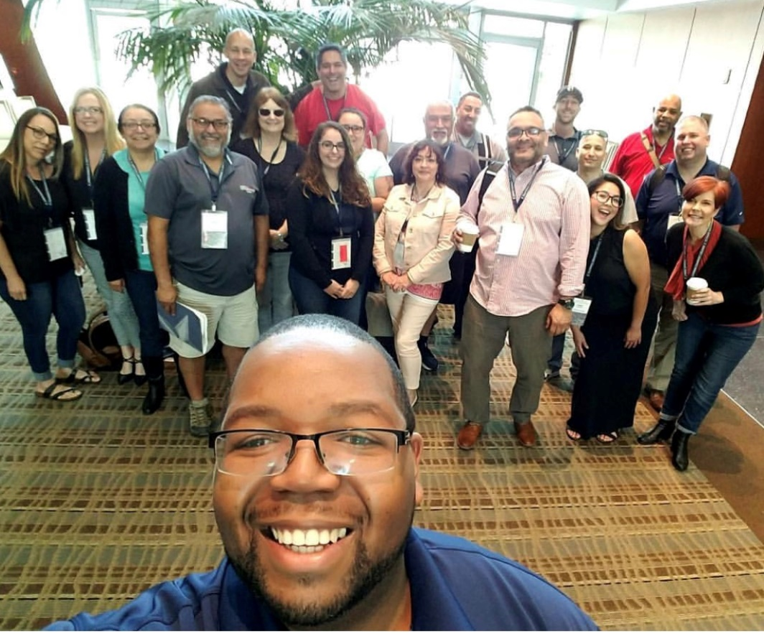
Veterans Served at MJC by the Numbers
Certified Veterans- As of Spring 2018 (302 students)
Non-Certified Veterans- 164 students

Slide 10
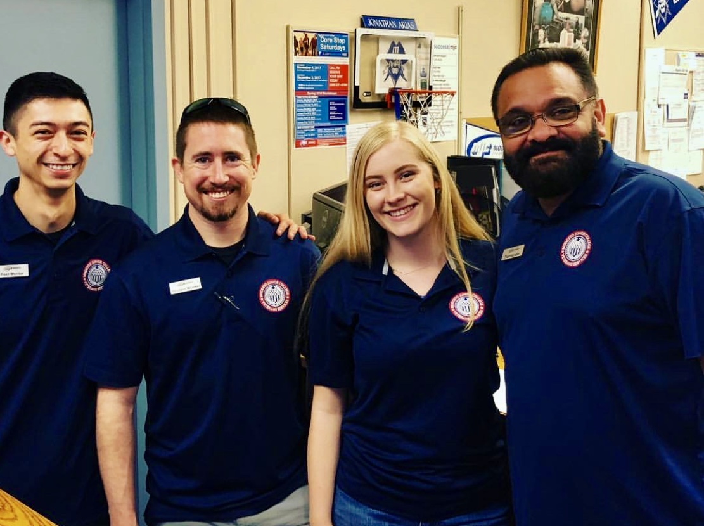
Veterans by the Numbers
As of January 31, 2016, there were close to 1.4 million people serving in the U.S. Armed Forces
As of 2014, the VA estimates there were 22 million military veterans in the U.S. population
About 200,000 current personnel are women

Slide 11
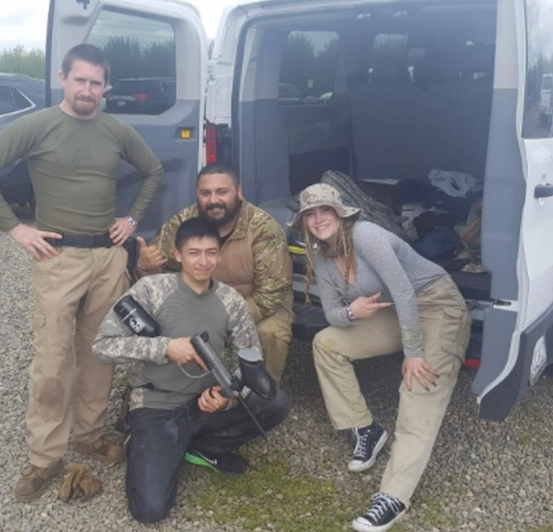
Veterans by the Numbers
Total active duty personnel for the five armed service:
ARMY: 471,397
NAVY: 326,276
AIR FORCE: 309,682
MARINE CORPS:183,917
COAST GUARD: 39,084
Data current as of March 2016. Marine Corps employees are a component of the U.S. Department of the Navy. SOURCE: U.S. Office of Personnel Management

Slide 12
The Branches of the Military
Branch Birth Date Military Role
Army (USA) June 14, 1775 Contingency Force, Long Term Operations
Navy (USN) October 13, 1775 Sea Operations
Marines (USMC) November 10, 1775 Beachhead Assaults
Air Force (USAF) September 18, 1947 Air and Space Superiority
Coast Guard (USCG) August 4, 1790 Defend U.S. Coastline

Slide 13
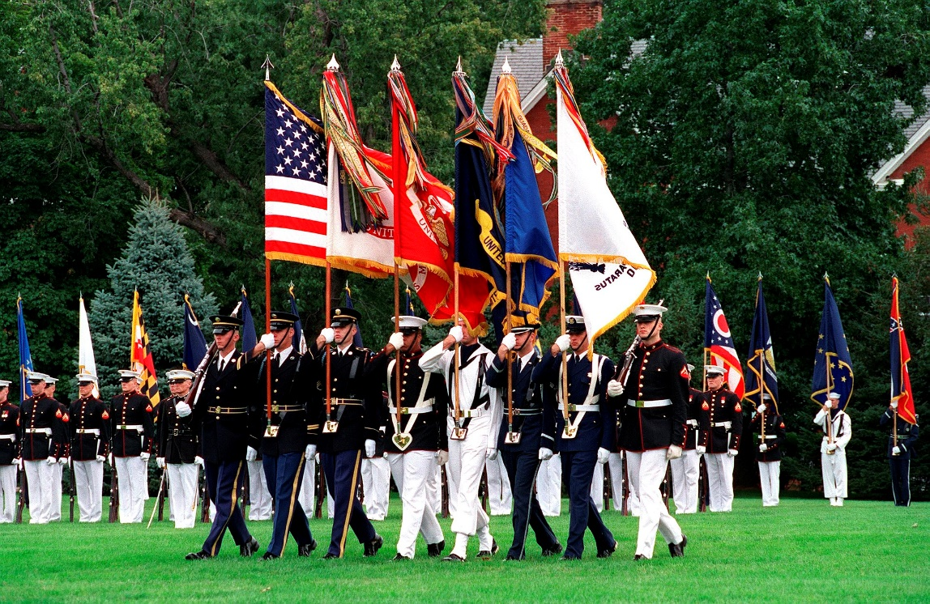
What Order are the Colors Presented?
In general, the order of precedence when displaying military flags together is the U.S. National Colors, U.S. Army, U.S. Marine Corps, U.S. Navy, U.S. Air Force, and U.S. Coast Guard.
However, in any period, such as in wartime, where the U.S. Coast Guard is operating as part of the U.S. Navy, the U.S. Coast Guard flag would precede the U.S. Air Force flag.

Slide 14
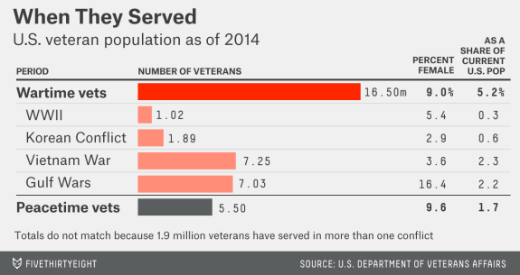
Veterans by the Numbers

Slide 15
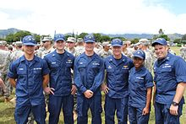
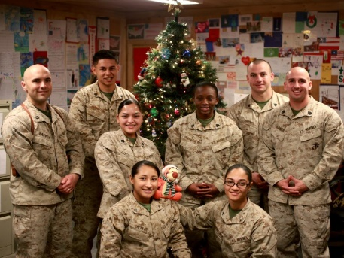
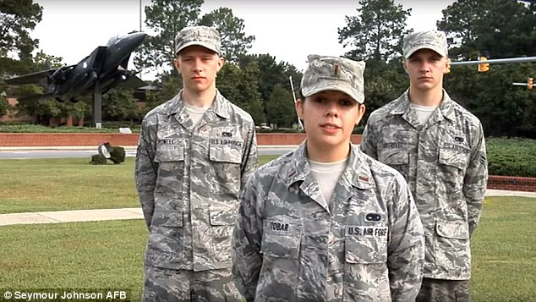
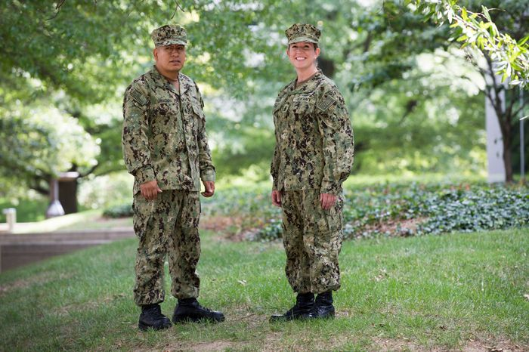
Military Names
Army-
Soldier
Coast Guard-
Coast Guardsman
Marine Corp-Marine
Air Force-Airman
Navy-
Sailor

Slide 16
Military Chain of Command

Slide 17
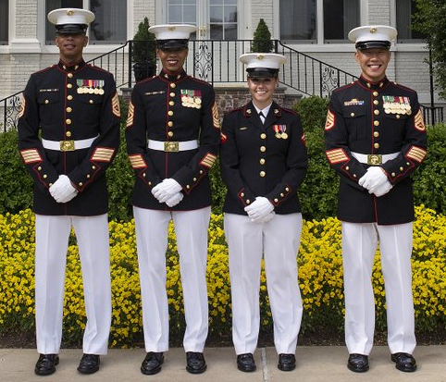
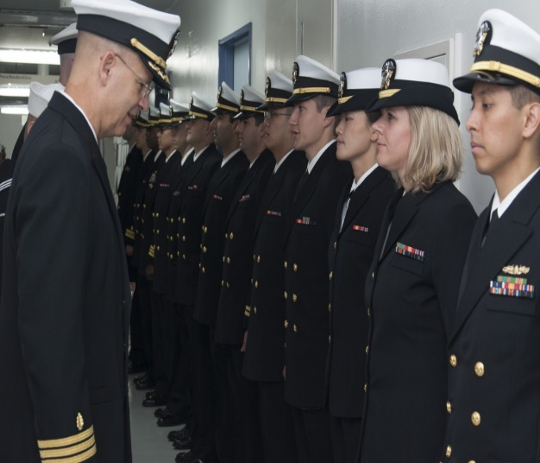
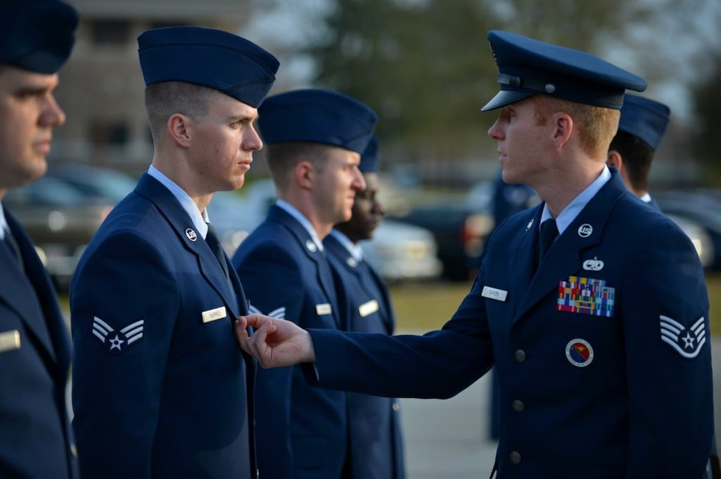
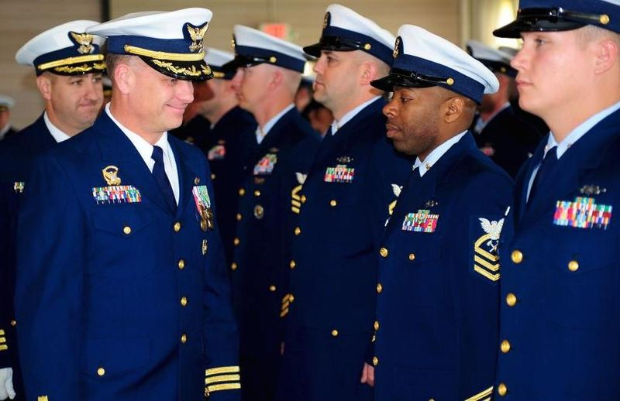
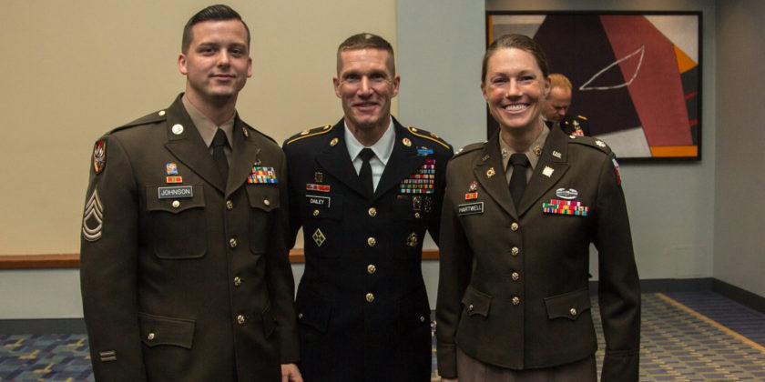
Military Culture

Slide 18
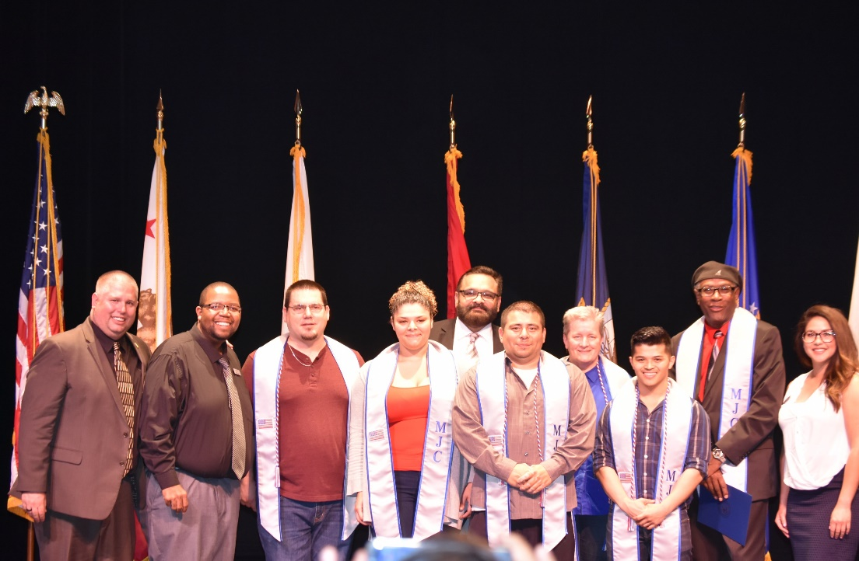
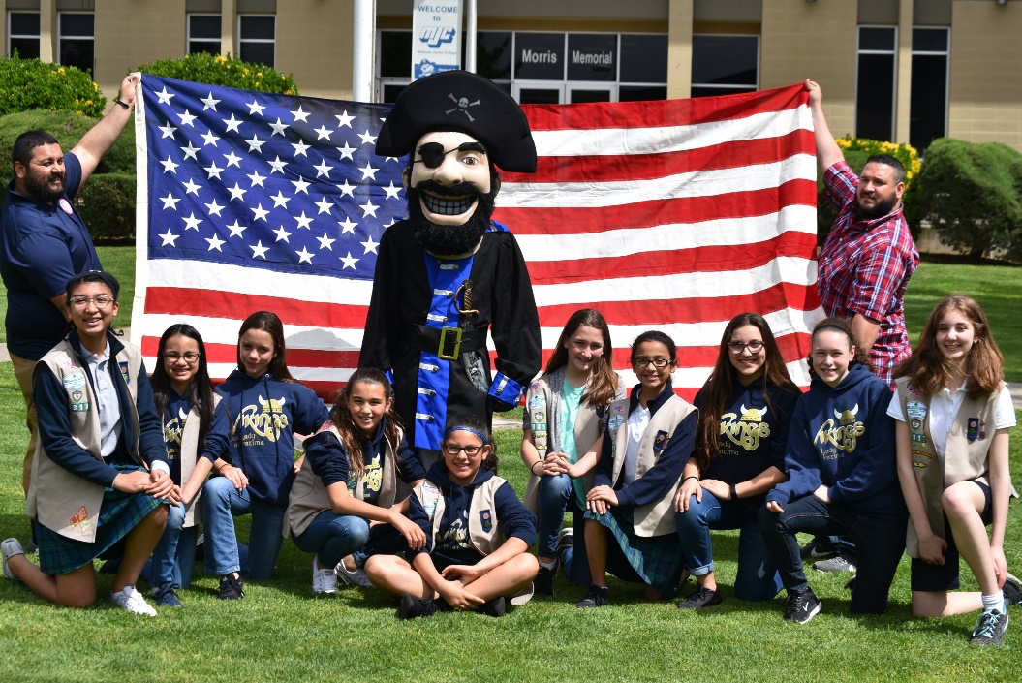
What to Expect from Veteran Students
U.S. Army – Long-term thinking: used to contingency planning- most likely will approach classes from a long term perspective
U.S. Marines – Assault: Spearhead Units, used to attacking the “beachhead” - most likely will approach classes from a “lets get it done now” perspective

Slide 19
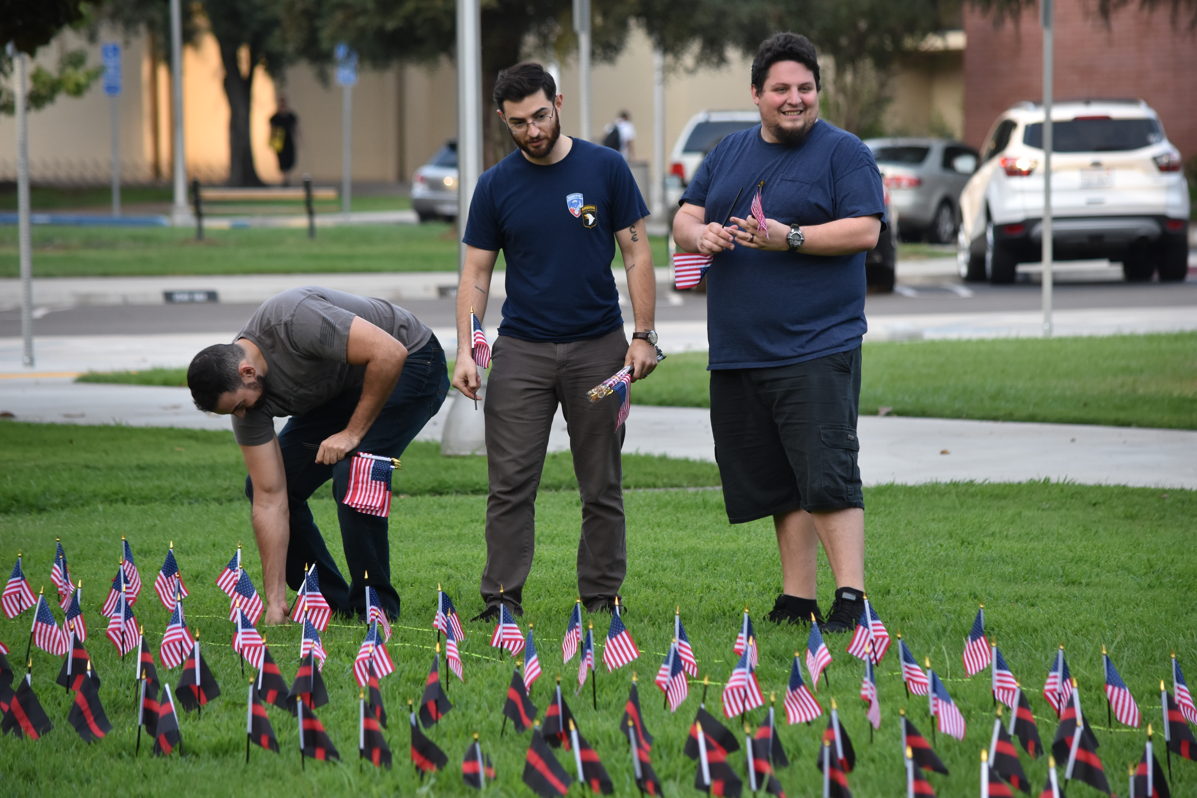
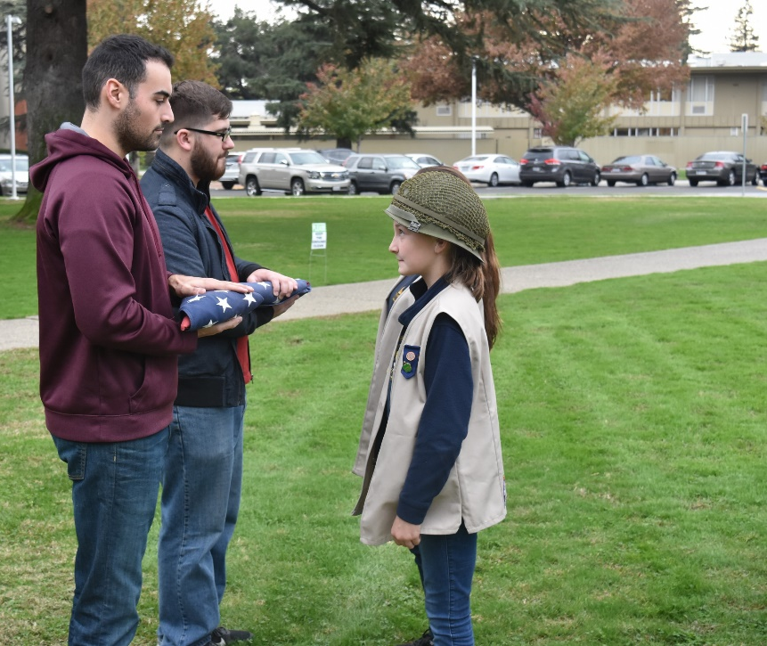
What to Expect from Veteran Students
U.S. Navy, U.S. Coast Guard – Work in departments/groups: used to working small squads and teams - most likely feel better with specific projects and within small groups
U.S. Air Force – Mostly “behind the scenes”: responsible for large projects and supplies/equipment. Most likely will approach class as deep thinkers and looking at the whole program from start to finish in segments

Slide 20
What to Expect from Veteran Students
Yes Ma’am, No Sir, Thank you (politeness, manners)
1800 hours (24 Hour time system)
26 Jan 2016 (the military way, the way they were taught)
Generally early to class (punctuality is critical to them)
Will either sit in the front of the class (to feel less distracted and able to pay better attention) or in the back of the class (defense mechanism)
Will generally be quieter and more reserved
until “trust” has been developed
Some students are still active duty
(active duty and reservists)

Slide 21
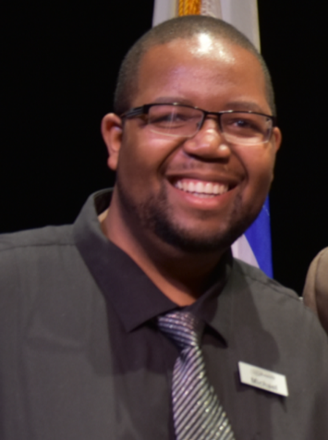
Common Disabilities
NOT ALL veterans have a Disability
Not ALL disabilities are visible
Tinnitus
Loss of Hearing
Reduction in sight
Traumatic Brain Injury (TBI)
Joint Injuries
Anxiety Disorder
PTSD

Slide 22
Post Traumatic Stress Disorder (PTSD)
Post Traumatic Stress Disorder develops after a terrifying ordeal that involved physical harm or the threat of physical harm. The person who develops PTSD may have been the one who was harmed, the harm may have happened to a fellow service member, loved one, or the person may have witnessed a harmful event that happened to a fellow service member, loved ones, or strangers.
People who have received a diagnosis of PTSD may feel stressed or frightened even when they’re no longer in danger.

Slide 23
PTSD Signs & Symptoms
Re-experiencing symptoms
Flashbacks—reliving the trauma over and over, including physical symptoms
like a racing heart or sweating
Bad dreams, nightmares
Frightening thoughts
Feeling numb
Becoming depressed

Slide 24
PTSD Signs & Symptoms
Avoidance symptoms
Staying away from places, events, or objects that are reminders of the experience
Feeling emotionally cut off from others
Feeling strong guilt, depression, or worry
Losing interest in activities that were once enjoyable
Having trouble remembering the dangerous event

Slide 25
PTSD Signs & Symptoms
Hyperarousal symptoms
Being easily startled
Feeling tense, “on edge” or jittery
Having difficulty sleeping
Having angry outbursts

Slide 26
PTSD
Not ALL veterans will suffer from PTSD
Not all veterans who do suffer from PTSD will show obvious symptoms
Some class topics can cause bad memories and trigger an emotional reaction
Some assignments become more difficult for veterans to write due to subject matter
A majority of the veterans who do suffer from PTSD have coping mechanisms in place
(i.e.: family, friends, counselors, pastors/clergy)

Slide 27
How to Help
If you feel a student/veteran is suffering from
or showing signs of a disability:
Ask how they are doing, talk to them
Do not push the subject
Let the student know that resources are available
Suggest that they stop by Veterans Services in the Student Center and speak with Michael Jackson

Slide 28
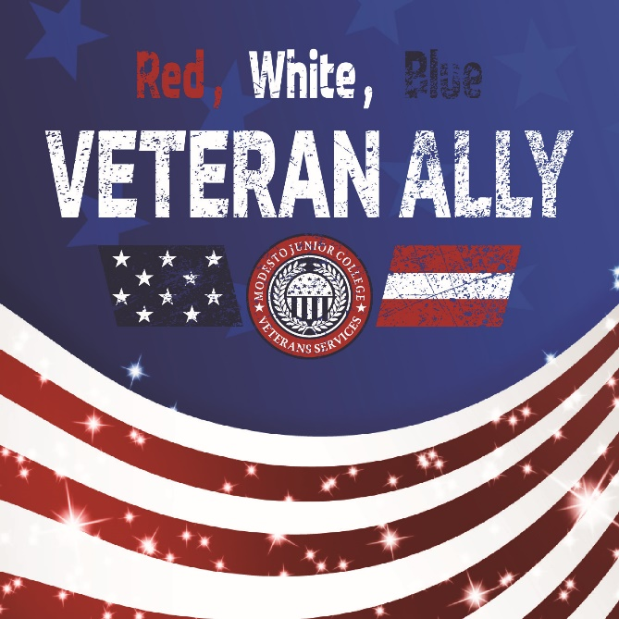
Red, White, & Blue Veteran Ally Sticker
The significance of your participation and meaning of the sticker:
Display the sticker in a visible spot
This sticker lets MJC Veterans and dependents know that they are supported
This sticker lets MJC Veterans and dependents know that you are a person with whom they can connect, take a class from, and ask for help
This sticker lets MJC Veterans and dependents know that they can connect to the college through you

Slide 29
MJC Veterans Services thanks you for participating and becoming a Red, White, Blue Veteran Ally!
Fernando Velez –
velezf@yosemite.edu
Megan Lee –
leeme@yosemite.edu
Michael Jackson – jacksonm@yosemite.edu
Bryan Justin Marks – marksb@yosemite.edu

