Slide 1
101
Articulation
MJC STUDENTS ARE
GOING PLACES
Letitia Senechal Miller, MJC Articulation Officer
FALL 2017

Slide 2
ABOUT THIS TRAINING
1st
in a series of trainings designed to inform, empower, and more authentically engage college personnel in the critical function of curricular articulation at MJC, in the district, and the State of California

Slide 3
ARTIC 101 OUTCOMES
After participating in this training, participants are able to:
Outline the primary mission of the California Community Colleges (CCCs)
Describe the relationship of CCCs to other systems and institutions of higher education in California
Distinguish between transferable credit and articulated credit at the point of transfer

Slide 4
WHO SHOULD pARTICIPATE
Faculty
who aren’t quite “crystal clear” the many functions and facets of articulation
new to teaching, to MJC, or to higher education in the state of California
in leadership roles on campus and in the state
embarking a comprehensive curricular update
Administrators
Student Services and Instructional staff

Slide 5
(in your own words)
what is articulation?

Slide 6
WHAT WE DO
THE MISSION OF THE CALIFORNIA COMMUNITY COLLEGES

Slide 7
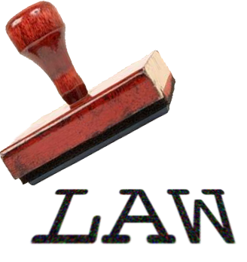
We find it in the ED CODE

Slide 9
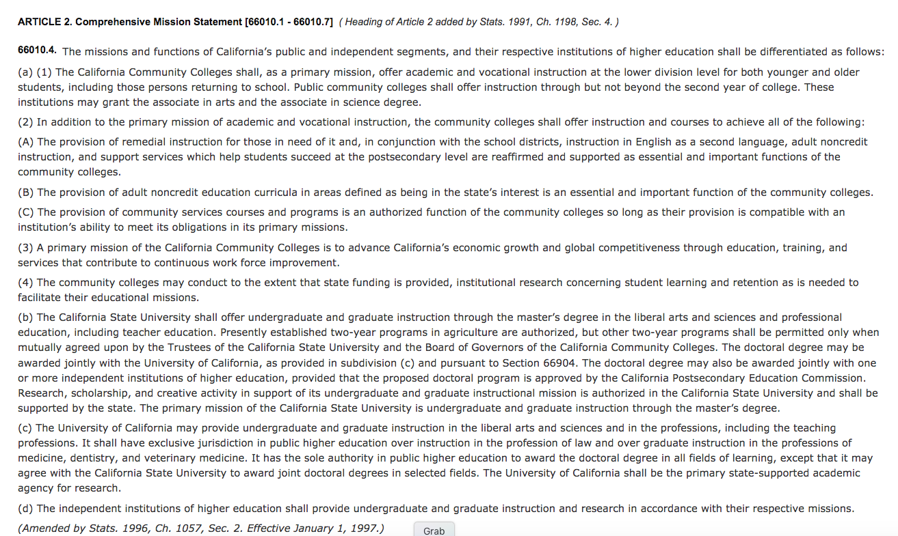
California Community Colleges
California State University
University of California
Independent institutions

Slide 10
HIGHER EDUCATION iN CALIFORNIA WHERE WE FIT
Independent Colleges & Universities

Slide 11
ESSENTIAL CONCEPTS
Baccalaureate degree: A 4-year degree experience of freshman, sophomore, junior, or senior-level coursework and general education “breadth” experience
Associate degree: A 2-year degree experience inclusive of freshman and sophomore-level coursework and general education “breadth”
Lower-division: Freshman and sophomore level curriculum
Upper-division: Junior and senior level curriculum
Transfer: The mechanism and process through which a student completes courses at one institution and later uses them to satisfy requirements another institution
Notes:
Some of these are obvious, but the implications of these parameters

Slide 12
OUR CCC SEGMENT
ARTICLE 2. Comprehensive Mission Statement [66010.1 - 66010.7]
66010.4. The missions and functions of California’s public and independent segments, and their respective institutions of higher education shall be differentiated as follows:
(a) (1) The California Community Colleges shall, as a primary mission, offer academic and vocational instruction at the lower-division level for both younger and older students, including those persons returning to school. Public community colleges shall offer instruction through but not beyond the second year of college. These institutions may grant the associate in arts and the associate in science degree.

Slide 13
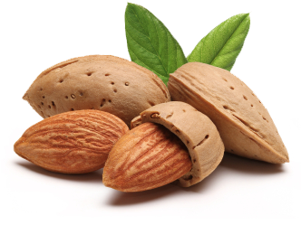
IN A NUTSHELL?
MJC’s primary mission in California:
To offer academic and vocational curriculum at the lower-division level
To offer curriculum through but not beyond the 2nd year of college.
grant AA/AS degrees

Slide 14
THE IMPLIED CURRICULAR MISSION
To prepare students to transfer to another segment by:
Designing lower-division courses to be used in lieu of courses to satisfy requirements of the other segments
Academically preparing students for upper-division coursework required by the other segments
Offering a pattern of lower-division courses that results in a broad learning experience and satisfies degree requirements within all systems

Slide 15
Ok, then. But how?

Slide 16
(Pretentious WORD)
Articulation
CRITICAL FUNCTION

Slide 17
The process and product through which courses and programs are formally recognized as comparable to educational experiences offered within another institution or system
Articulation

Slide 18
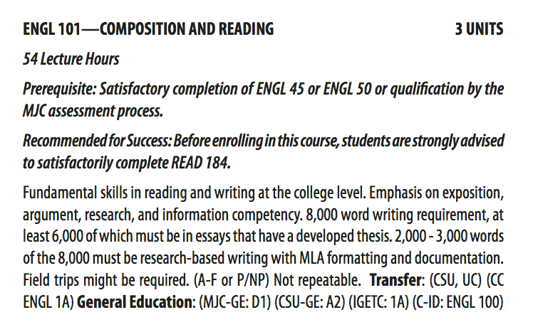

Slide 19
what does this mean?

Slide 20
Back to the ED CODE

Slide 21
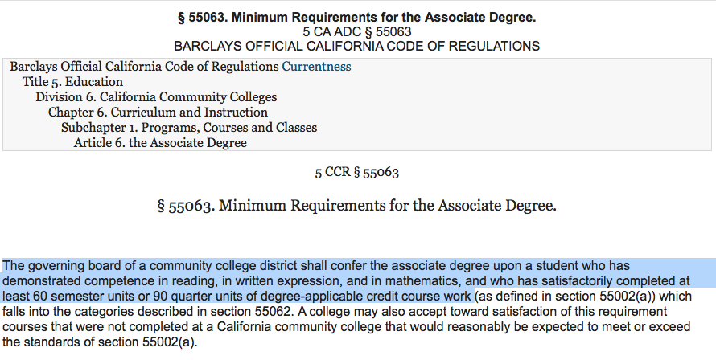

Slide 22
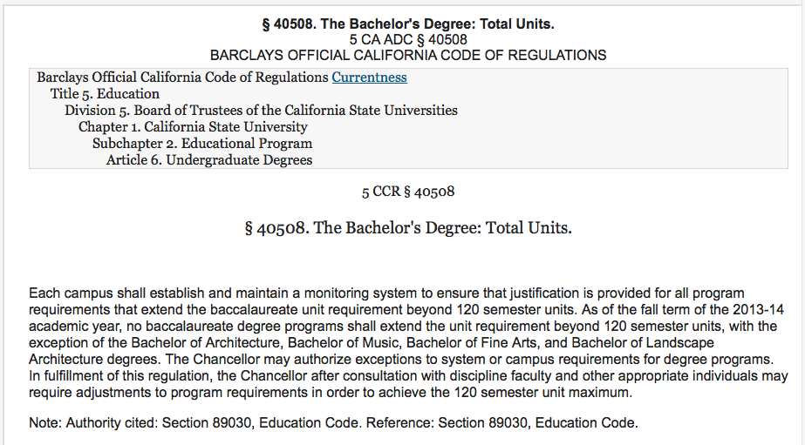

Slide 23
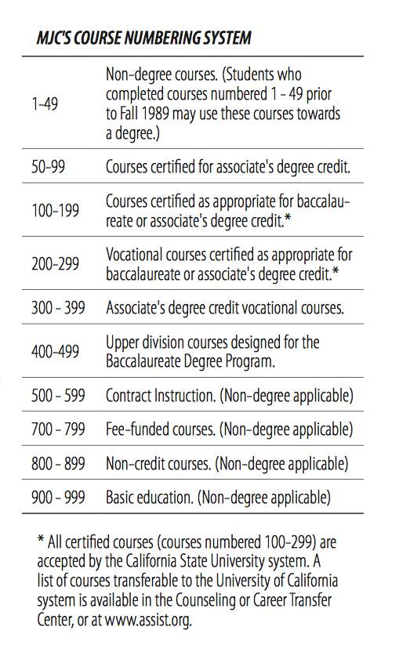
Course Numbering System
Courses numbered 100-299 at Baccalaureate & Transfer* Level
Because CCC baccalaureate level
courses are not formally recognized as transferable, we do not classify
them as such at this time.

Slide 24
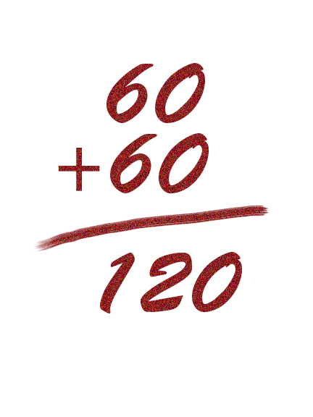
TIME FOR SOME TRANSFER MATH
Typical lower-division units for associate degree
Total upper-division units
Total units allowed for baccalaureate degree*
*A handful of majors allow for exceptions.

Slide 25
ASSOCIATE DEGREE INGREDIENTS
Transferable, lower-division baccalaureate units
COURSES NUMBERED
?
100-299
Electives
units
+
TRANSFERABLE, LOWER-DIVISON
ASSOCIATE & BACCALAUREATE-LEVEL COURSEWORK
Associate Degree Major Requirements
18-34* units
+
General Education Breadth
37-39 units
COURSES NUMBERED
1-99
+
Competencies,
Basic Skills, Prereq sequences
?
units
PREPARATION FOR BACCALAUREATE CURRICULUM

Slide 26
WHAT THIS MEANS:
At a minimum, the course transfers
to the system(s) indicated as elective credit for the baccalaureate degree.

Slide 27
AT The MOST
The CSU and UC systems allow CCC students to apply a
maximum of 70 units
of lower-division coursework to the baccalaureate degree
Transferable baccalaureate units
Electives
?
units
+
Associate Degree Major Requirements
18-34* units
+
General Education Breadth
37-39 units

Slide 28
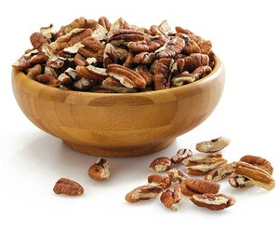
WHAT THAT MEANS
After GE and major requirements are satisfied for the associate degree, MJC students often have only a handful – if any – units available for courses that
REQUIRED
UNITS FOR
TRANSFER
unless those courses have…
HMMMMM….

Slide 29
Articulation
Adds value to baccalaureate CCC courses at the point of transfer by codifying that a CCC course may be used in lieu of a comparable course at the transfer institution
to satisfy a lower-division baccalaureate requirement in the major
prepare for upper-division coursework

Slide 30
An Articulation Officer’s
Credo
Does a given course evidence potential for any type of articulation?
Beyond 60 units for degree, are students helped by courses that merely transfer as elective credits? If so, how? Can we measure it?
Where are our articulation gaps? Do we know?
Does our curriculum seamlessly fold into four-year programs?
How do we fairly, accurately, and consistently distinguish baccalaureate preparation from baccalaureate rigor in our curriculum?
How do we maintain and leverage a robust, current knowledge of baccalaureate trends to most meaningfully support students at the point of transfer? What tools do we have.

Slide 31
COMING UP IN THE SERIES

Slide 32
EXPLORING ARTICULATION RESPONSIBILITIES & MECHANISMS
CSU EO 167: CCC right to self-determine baccalaureate level courses
Course-to-Course articulation agreements between institutions
CSU-GE pattern placement approval
Approval for UC Transfer Course Agreements (TCA) allowing for
MJC courses to transfer as elective credit
UC Transfer pathway articulation
IGETC Pattern placement
Transfer Admission Agreements (TAGs)
C-ID Descriptor approval
Transfer Model Curricula that are the template different ADTs
Intra-district Equivalency between MJC and Columbia College

Slide 33
UNITS REQUIRED
https://www.calstate.edu/AcadAff/codedmemos/AA-2013-02-Attach3_120_Unit_Toolkit.pdf
http://admission.universityofcalifornia.edu/counselors/transfer/advising/transferring-credits/index.html
https://govt.westlaw.com/calregs/Document/I2AF461135D25489BA4B7642B6A47CB81?viewType=FullText&transitionType=DocumentItem&contextData=(sc.Default)
§ 40508. The Bachelor's Degree: Total Units.
5 CA ADC § 40508

