Slide 1
English Department
Write
Read
Think
Request for Replacement and Growth Positions
2016-2017

Slide 2
Every Student…
Every student at MJC must pass through the English sequence to earn a certificate or an AA/AA-T degree.
has needs.
The English Department has the highest enrollment in any program at MJC with 9313 students enrolled in 2015-2016.
Yet, despite the fact that we have added 65 sections in the past three years, we maintain waitlists of more than 5700 students each year.
Thus, adding human resources to English is essential to growth at the college.

Slide 3
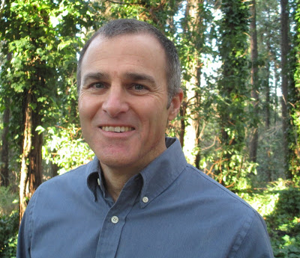
Our Request:
Replacement Requests:
Michelle Christopherson, Retirement (Full-Time)
Dimitri Keriotis, Reassignment (Full-Time)
Growth Requests:
One Additional Full-Time Faculty
Additional Faculty Reassigned:
Nita Gopal 100%
Shelley Circle 20%

Slide 4
The Numbers
 | 2012-2013 | 2013-2014 | 2014-2015 | 2015-2016
FT Faculty | 23 | 24 | 25 + 1 FT temp | 26
FTEF | 76.71 | 81.48 | 89.8 | 95.55
# of sections | 281 | 296 | 321 | 346
% PT (# of sections) | 33% (92) | 39% (115) | 42% (134) | 51% (159)
% FT (# of sections) | 67% (188) | 61% (180) | 59% (189) | 49% (186)
FTES | 1027.182 | 1082.061 | 1190.322 | 1262.20
Cost per FTES | $2,286.84 | $2,845.11 | $2,819.65 | $2,813.62
Success Rate | 64% | 66% | 63% | 62%
Fill Rate (Waitlisted) | 103% (6008) | 100% (4760) | 101% (5720) | 100% (5763)
WSCH/FTEF | 403.00 | 401.27 | 397.60 | 400.06
Number of Majors | 368 | 329 | 321
Number of Degrees | 22 | 11 | 17 | 34
FT to PT Faculty Ratio | 33/67 | 39/61 | 42/59 | 46/54

Slide 5
Despite an increase in section offerings (65 in the past 3 years), students are remaining steady on waitlists (5763 in just the past year alone)…
Currently, 51% of sections are taught by PT faculty.
Despite recent hires, the English Department has only increased
by one full-time faculty member since the recession.

Slide 6
Productivity: Enrollment
In fall 2016, we added ENGL 45 sections that allow us to go from 22 sections to 11 sections yet still serve the same number of students.
Plus, more sections were added (+65) than the previous year and waitlist numbers still went up. Enrolled students increased by nearly 700 students and waitlisted students increased slightly from 2952 to 3059.

Slide 7
Productivity
The English department served more students (nearly 200 students) than it did in the year prior.
And, we did it with less money (approx. $30 less per student) than last year.

Slide 8
Productivity Comparisons
Fill Rates in the English Department have been above 100% and higher than the college average for five years (as much as 17% higher, including this year)

Slide 9
Productivity Comparisons
The English Department has been slightly ahead or on average (between 80-83% each year) for retention rates.

Slide 10
Comparisons: Overload
While college-wide trends show FT faculty increasing their overload, the demands of teaching writing-intensive courses have actually caused English faculty to decrease their otherwise small overload requests.

Slide 11
Comparisons: Fill and Retention Rate
The English Dept. has a HIGHER fill rate (as much as 17% higher)
and a
HIGHER retention rate
than the college average.

Slide 12
Innovation: Curriculum
Course Outline of Records are up to date.
Program Review completed on time.
Developed two-year Guided Pathway for students
Involved in Assessment Changes for Transfer-Level Readiness
Two new accelerated courses
ENGL 45 (approved and being taught)
ENGL 100 (in the process for approval)

Slide 13
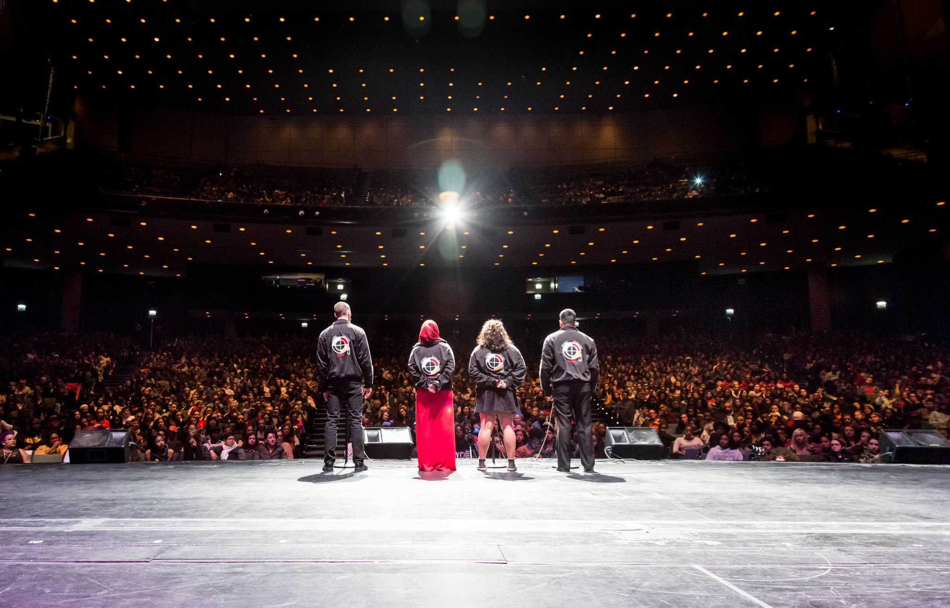
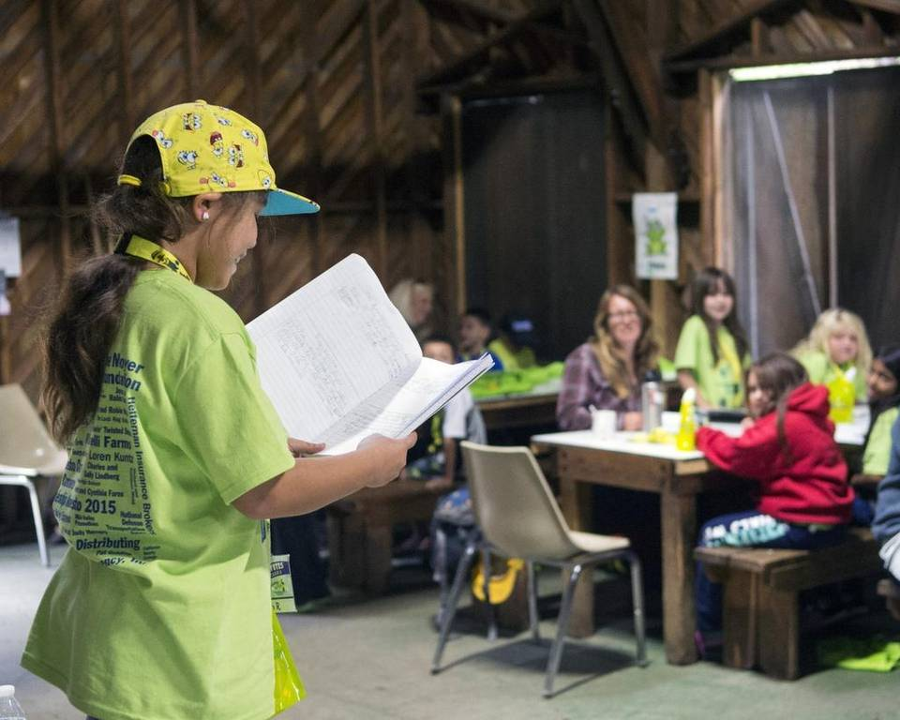
Innovation and Connection: Community
Currently, English faculty and student interns are working with 8 area high school English teachers and their students to create poetry slam teams in order to compete at the State Theater in April for the first annual "Generation Lit: Central Valley Youth Poetry Slam."
Additionally, through the Gallo Center for the Arts "Teaching Artists in the Schools" Program, English faculty have been teaching creative writing workshops in middle and high schools, offering teacher trainings, and providing writing workshops for SCOE's "Roadtrip" Program for
at-risk 6th graders.

Slide 14
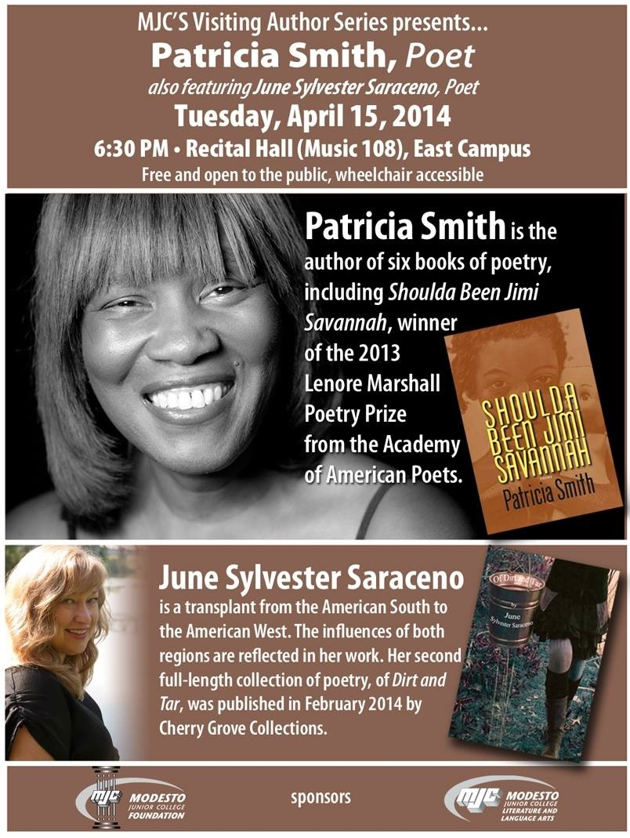
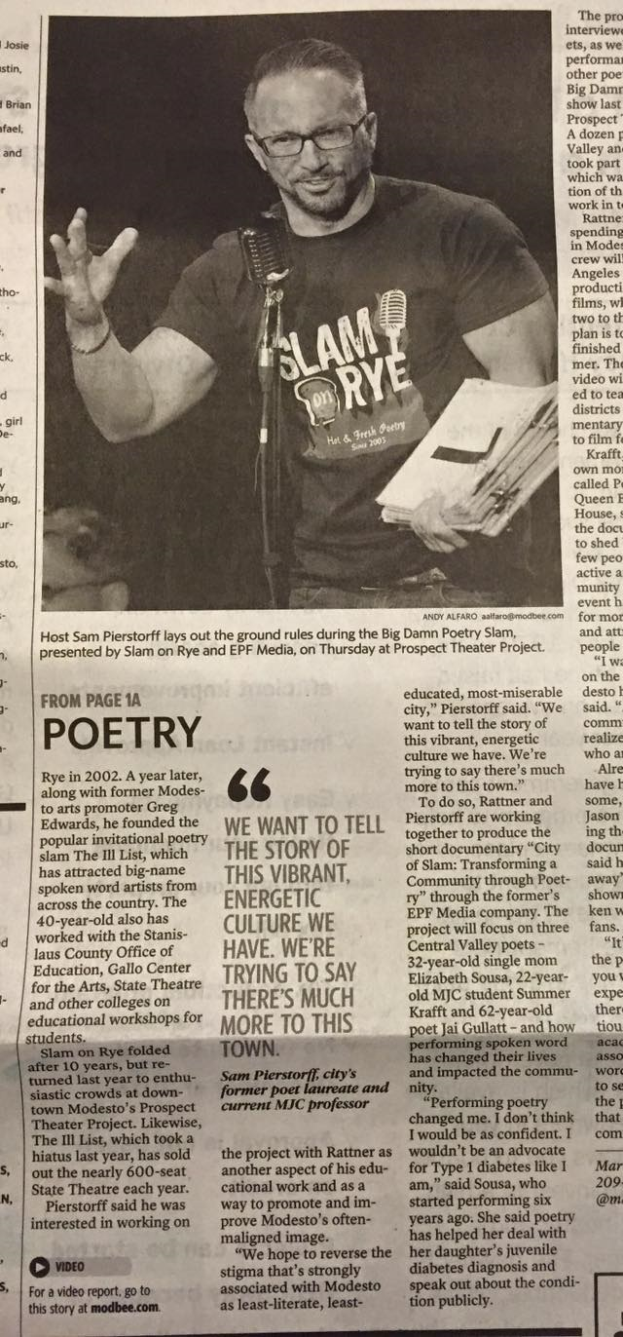
Innovation and Connection: Community
The MJC READS initiative with support from ASMJC has brought in award winning and local visiting authors such as National Poetry Champion and American Book Award winner Patricia Smith, bestselling author Gary Soto, and local writer Dimitri Keriotis. These free events each hosted 100-200+ students and community members.
Creative writing faculty have been visiting writers and guest speakers at UC Merced, UOP, Fresno's LitHop Festival, area middle and high schools, Rotary and Kiwanis clubs, and poet Sam Pierstorff was commissioned to write and record a video poem, "A Love Letter to Stanislaus," on behalf of Stanislaus County that has been show by the City Council, the Stanislaus County Board of Supervisors, and featured on the City of Modesto's website: https://www.youtube.com/watch?v=_9igJ0i4jYc

Slide 15
Summary
In 2015-2016, the English department maintained one of the largest enrollments (9,313) and highest waitlists (5,763), while increasing section offerings (65+) and FTES (1262.20, up from 1027.18 in 2012-2013).
While we currently have the same number of FT faculty since 2014, our FTEF has increased from 81.48 to 95.5 during that same period.
FT faculty continue to innovate and maintain significant ties to our community.
Each semester, classes are cancelled due to lack of available staffing caused by the ebb and flow of adjunct leaving to other jobs.

