Slide 1
CORA Certificate Training program

Slide 2
Center for Organizational Responsibility and Advancement Housed under the CCEAL (Community College Equity Assessment Lab) at San Diego State University Co-directors are Dr. Frank Harris III & Dr. Luke Wood
CORA Quick Facts

Slide 3
Certificate Training Program
Opportunity to train our staff, faculty, administrators, and students on how to support students of color, especially men of color
Each of the five trainings take approximately 15 hours to complete
Modules consists of an overview of the topic, research articles & other assigned readings, frequently asked question regarding the topic, discussion questions, and an assessment
Each training must be completed within 30 days of purchase, so do not purchase all trainings at once

Slide 4
Trainings:
Racial Microagressions -This program provides educational stakeholders with an introduction to racial microaggressions and their numerous manifestations in educational settings, and strategies on how to reduce their prevalence
Supporting Men of Color in the Community College - This course provides educational stakeholders with strategies and approaches that can be used to foster enhanced learning, development, and success among college men of color
Teaching Boys and Young Men of Color - This course provides PreK-12 educators with strategies and approaches that can be used to foster enhanced learning among Black and Latino boys
Teaching Men of Color in the Community College - This course provides community college instructional faculty with strategies and approaches that can be used to foster enhanced learning among college men of color
Unconscious Bias - The program highlights variation definitions of unconscious associations, discusses the influence of these associations on student success and provides pathways to better understand unconscious bias in education

Slide 5
How to Enroll in Courses

Slide 6
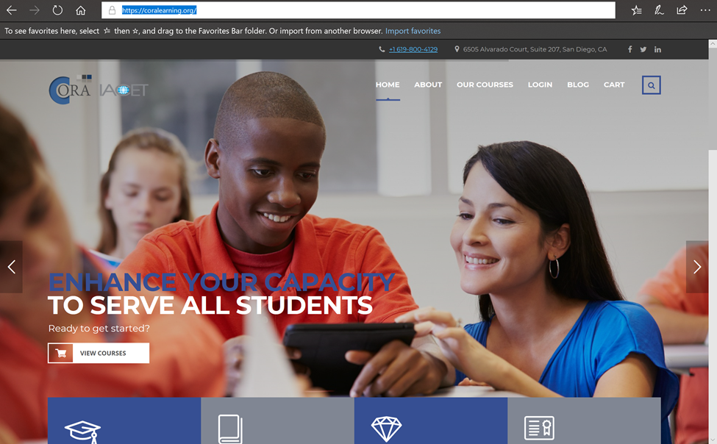
Visit https://coralearning.org/ Click on “Our Courses”

Slide 7
Choose from the course options Hover over an image to “View More”

Slide 8
Read the description for the course Select “Enroll In Course”

Slide 9
The course will be added to your cart, and you will be prompted to “View Cart” You will then be prompted to pay for the course; type in “modesto” and click “Apply Coupon” The total will change from $200 to $0; click “Proceed to Checkout”

Slide 10
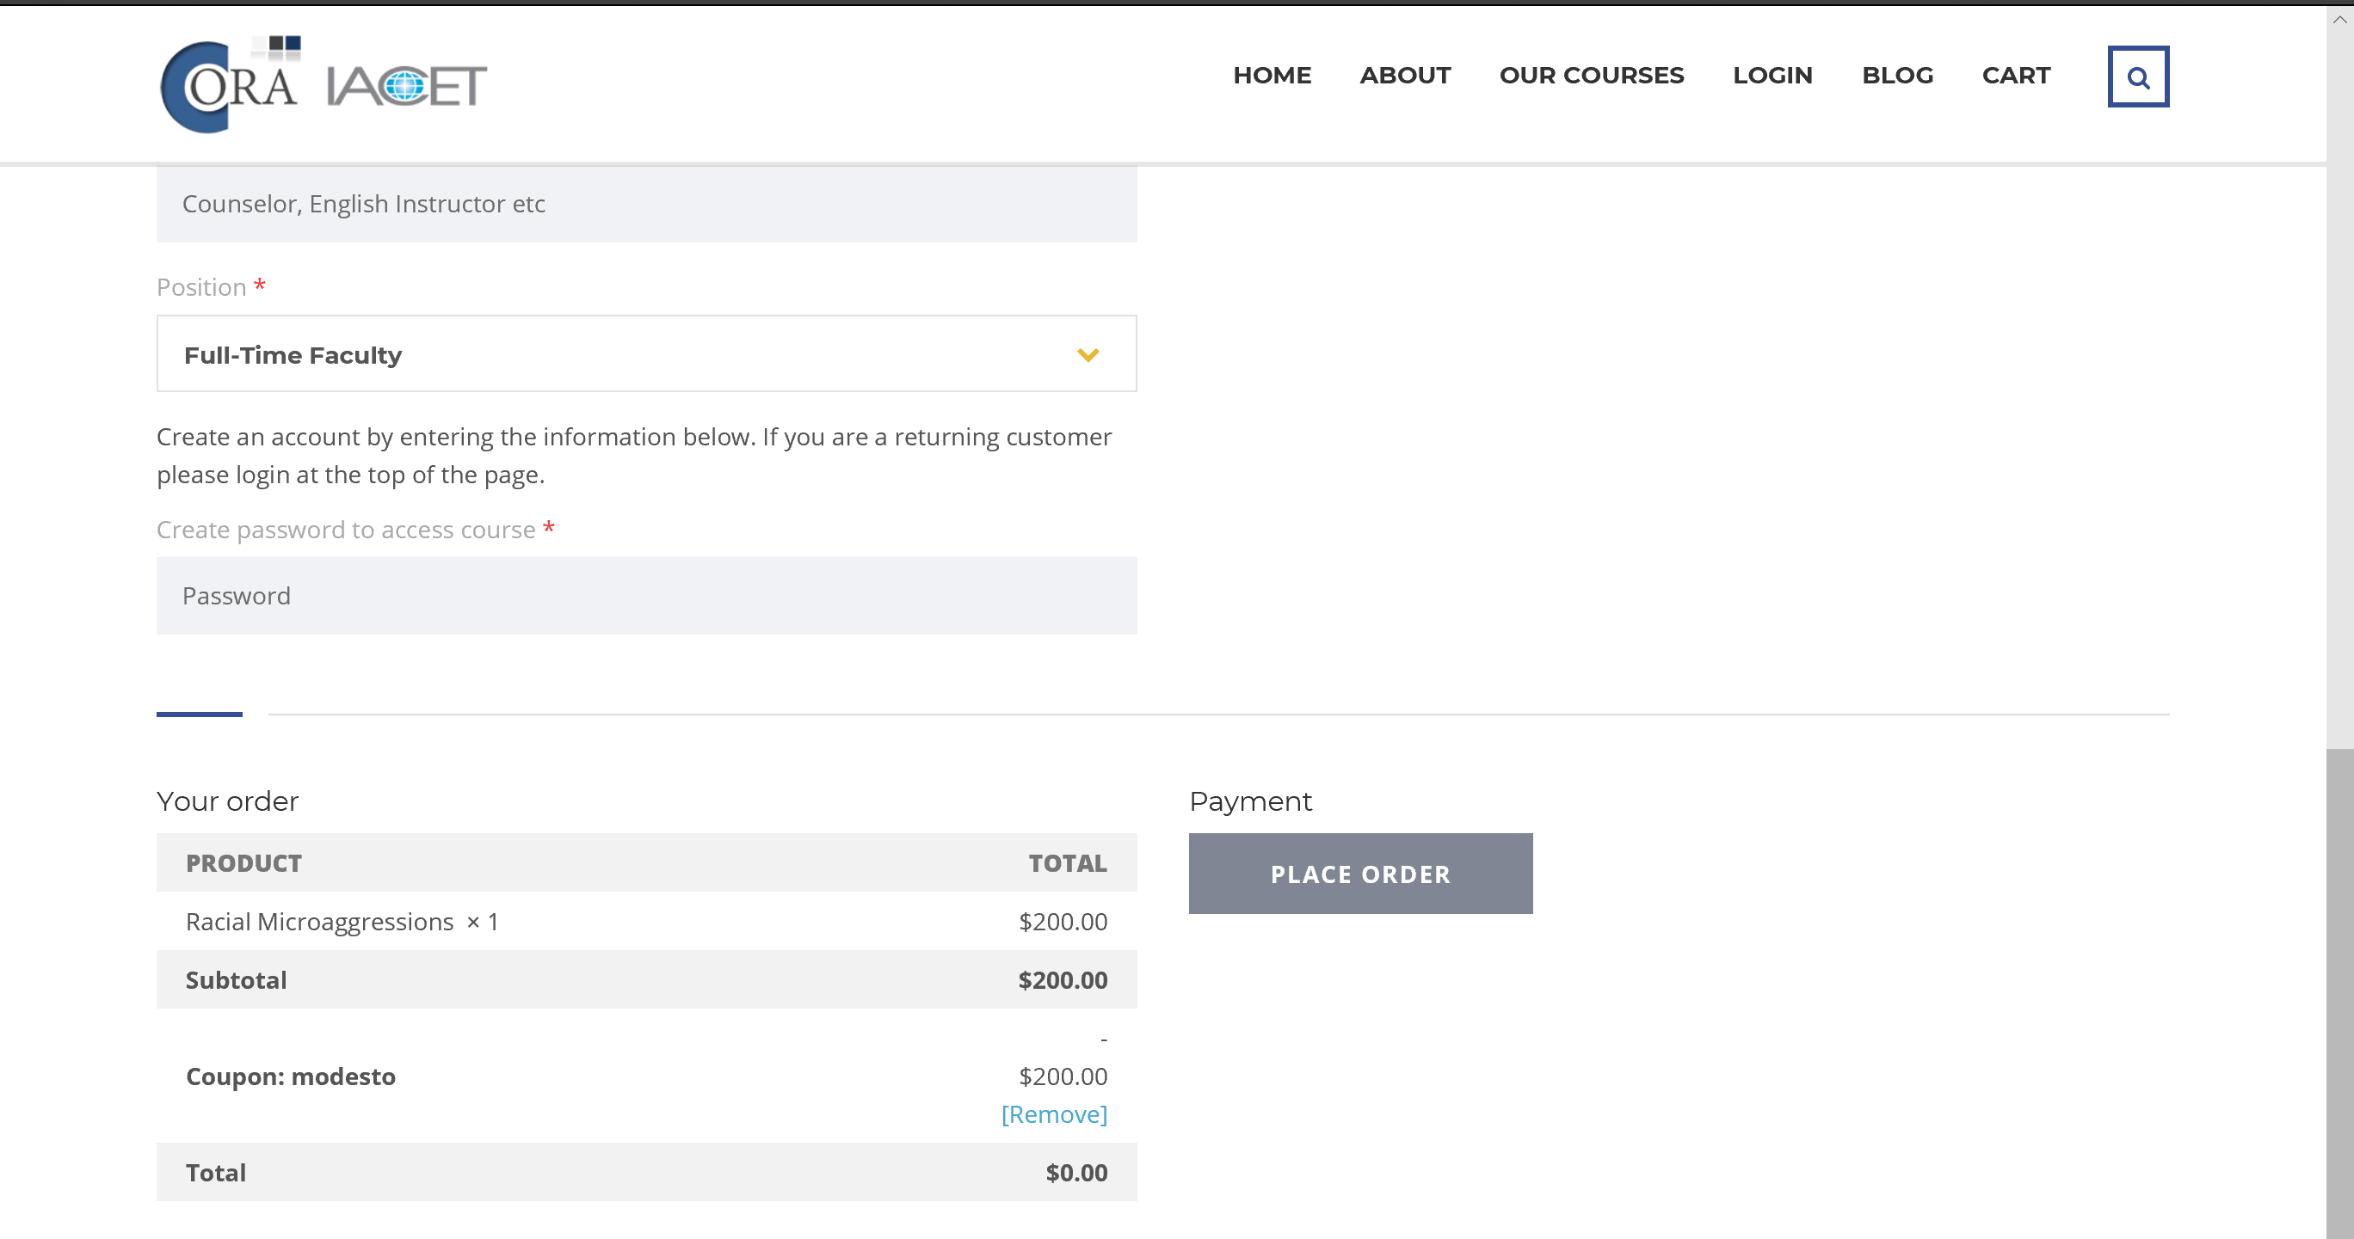
You will be prompted to enter “Billing Details,” but there is no prompting for credit card info (no charge to you) Place Order

Slide 11
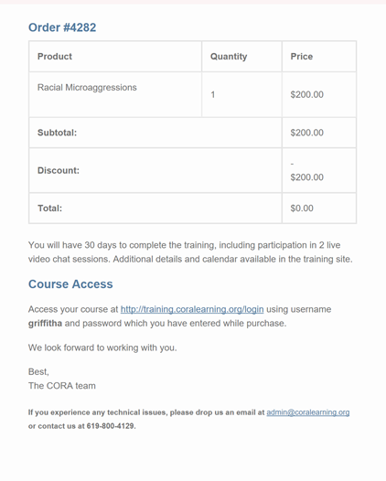
You will receive two emails: 1) Showing proof of purchase 2) An email stating that your account is ready and instructions on how to access the courses

Slide 12
After purchase, you are prompted to create a log-in and password, insert those items here

Slide 13
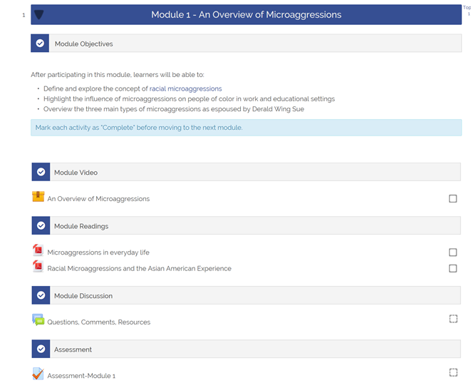
Select the course you have purchased Begin and complete modules

