Slide 1
Perkin & Strong Workforce August 23, 2023
MJC Institute Week

Slide 2
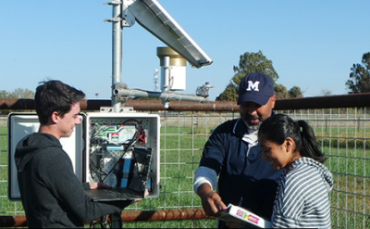
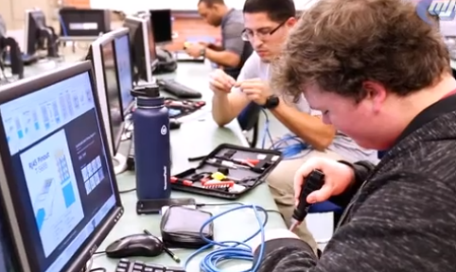
42-45% of students

Slide 3
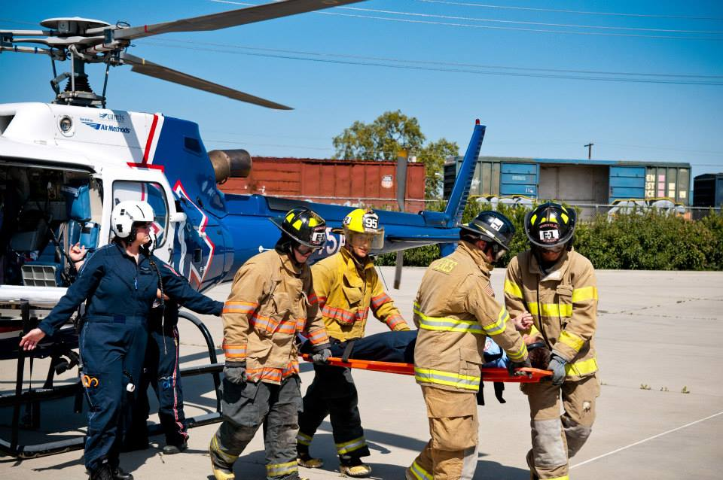
Value of Career Technical Education Programs
Value proposition for our Students
Certificate and/or Degree: Stackable
Knowledge and Skills: Value and vetted by Industry
Work Base Learning: Apprenticeship, Clinical, Externship, Internship, Career Job Resume & Interviewing, Career Fairs and Networking
Social Justice: Access and Economic Mobility
Value proposition for Community
Respond to Industry Trends
Respond to Labor Needs
Expand Tax Contributors to Economy
Etc.

Slide 4
MJC College Priorities… It’s About our Students
Similarities:
Proposals
Reporting
Carl Perkins: “Special Populations enrolled in CTE Programs”
Federal Funded (12 months)
MJC Carl Perkins Web Page
Carl Perkins Core Indicators
Strong Workforce Program: “More & Better”
Enrollment, Completers, Wage Earning
State Funded (24 months)
MJC Strong Workforce Web Page
Launch Board
Centers of Excellence

Slide 5
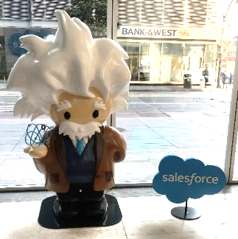
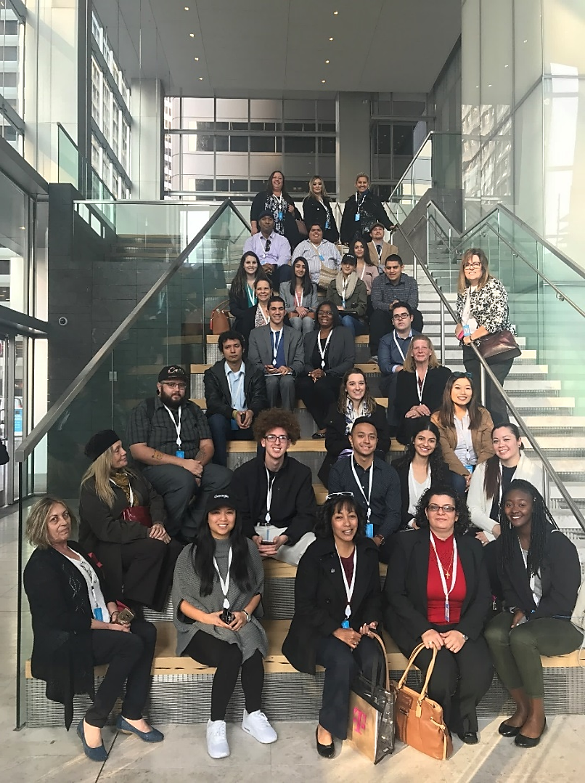
Data and Metrics
How is a Student Identified?
When students complete their application (matriculate) at MJC their profile details helps to ID if they are in a special population category.
When students complete CTE online survey each semester from the Institutional Effectiveness.
Student enrolled in a CTE Course: SAM Code: A,B, C, or D.

Slide 6
Strong Workforce Program Initiative
Strong Workforce funding is intended to help colleges provide More and Better CTE.
More enrollments
More completions
More students acquiring jobs

Slide 7
Strong Workforce Program Initiative
Strong Workforce funding is intended to help colleges provide More and Better CTE.
Increase FTES per CTE class offered
Increase # of CTE sections offered
Increase 9 units in CTE completed by students
Increase CTE Course Success Rates
Increase CTE Persistence Rates
Increase CTE Certificate, Degree or Transfer Rates
Increase Work Base Learning

Slide 8
Strong Workforce Program Initiative
Strong Workforce funding is intended to help colleges provide More and Better CTE.
Student ID
Student enrolled in CTE Courses (Sam Code: A, B, C or D)
Students Completing CTE Classes
Students Completing 9 units in CTE Programs
Students Completing Certificate, Degrees and/or Transferring

Slide 9
Strong Workforce Program Initiatives
Agriculture: Irrigation Technology
Agriculture: Farm Store
Allied Health: MJC Columbia Partnership
Sports Medicine
Child Development
Business & Entrepreneurship
Building Inspection & Management
Computer Science: Cyber Security
Dental
Digital Media
Engineering & Industrial Automation
ESL: CTE Integrated English Training Models
Paramedics
Welding

Slide 10
2023-24 Application Dates
Application Due Date: EXTENDED DEADLINE December 20, 2023 by 12pm via email to Rebecca Heinrich
Committee Review: January – February 2024
24/25FY Award Announcements: March 2024
24/25 Award Budget Setups: July/August 2024

Slide 11
Carl Perkins & Strong Workforce
Carl Perkins Funding: 12 months
Strong Workforce Funding: 24 months
Note: Strong Workforce resources are allocated to support RAFC priorities. This varies by year. Has been $350 to $900K. This number is determined after projects are awarded.

